Slide 1
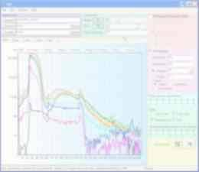


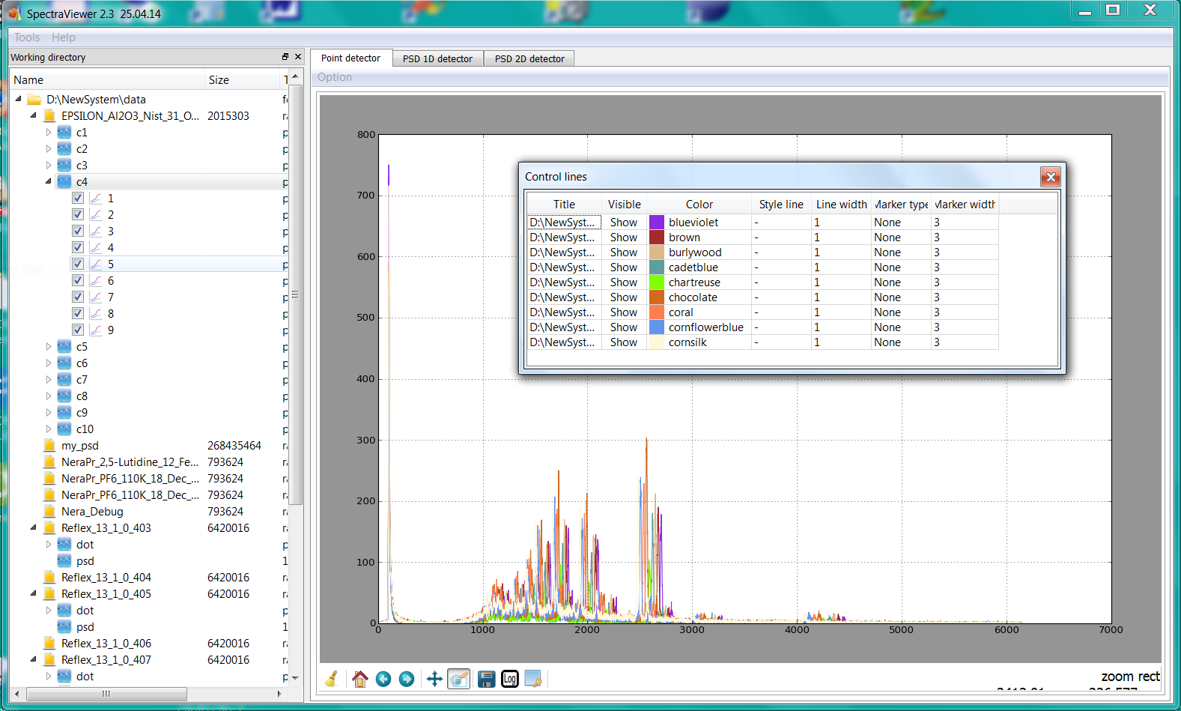
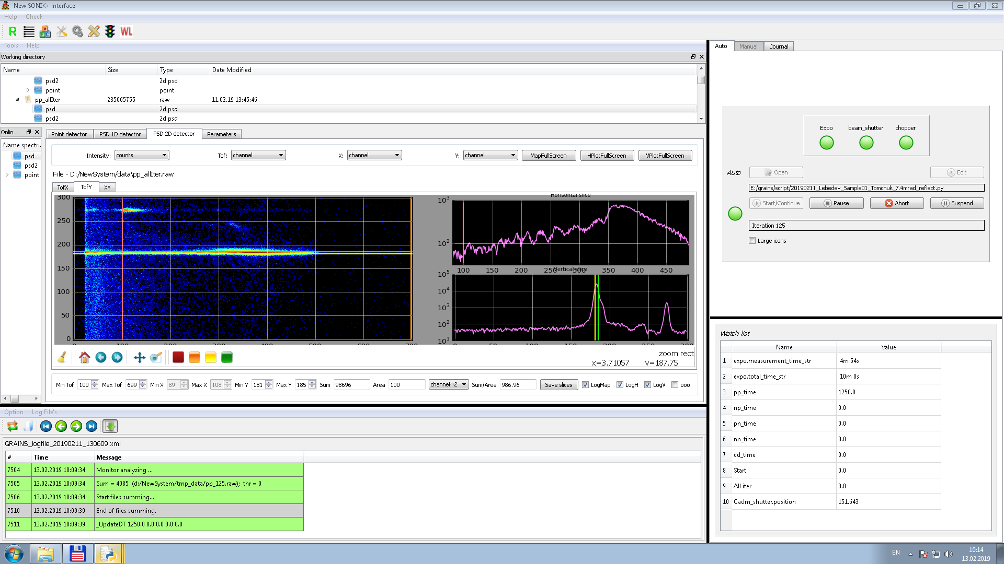
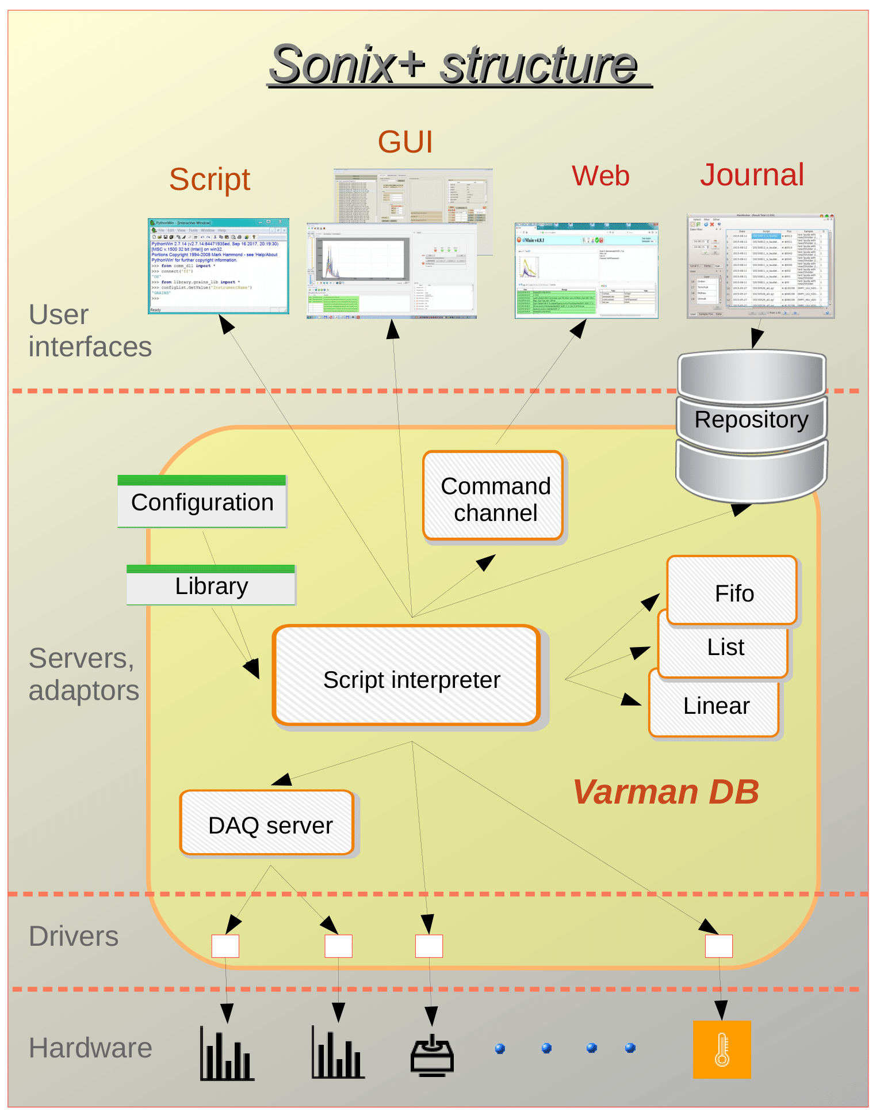
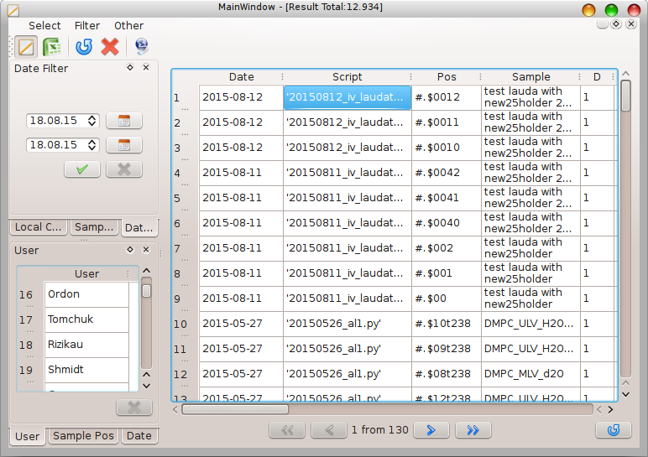
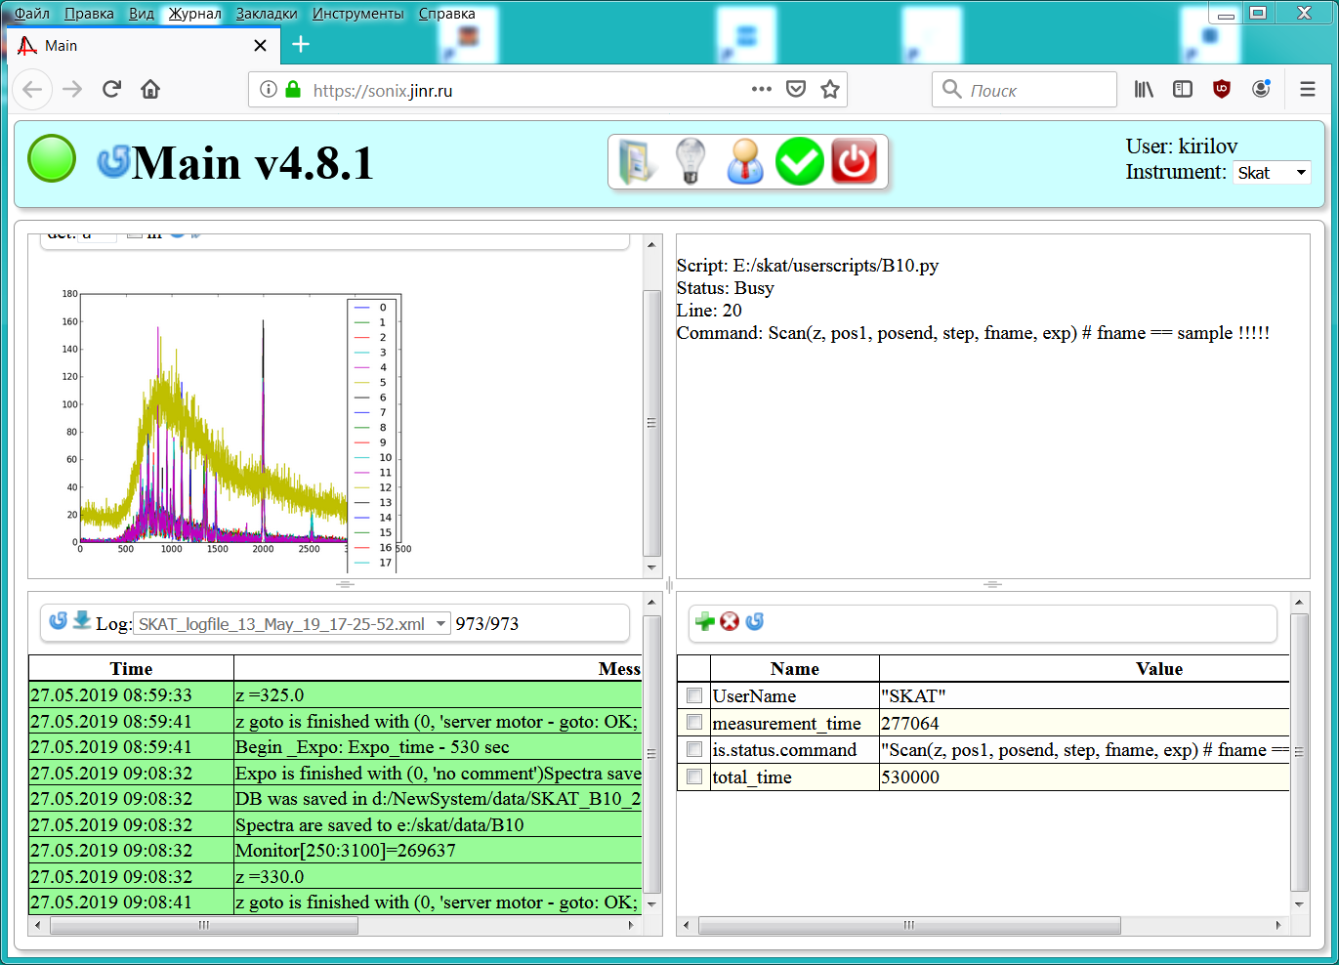
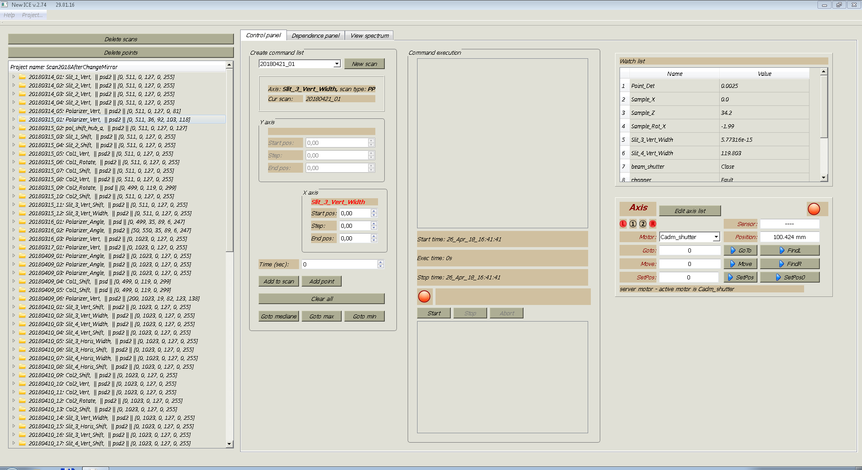
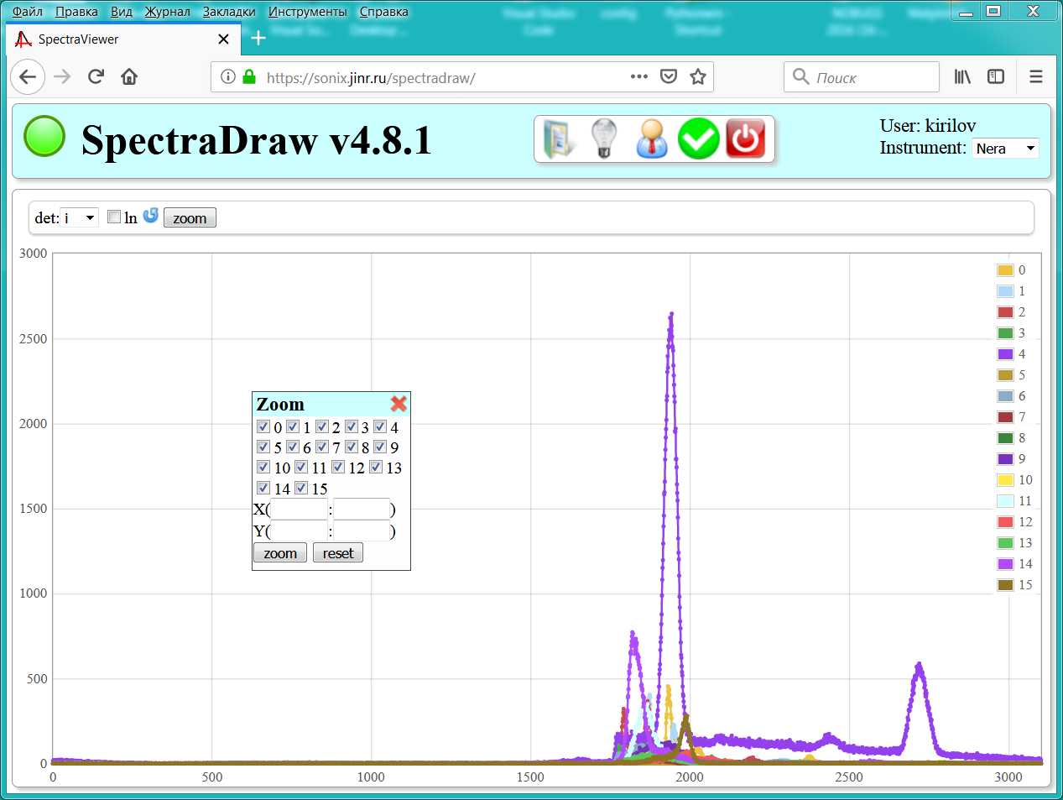
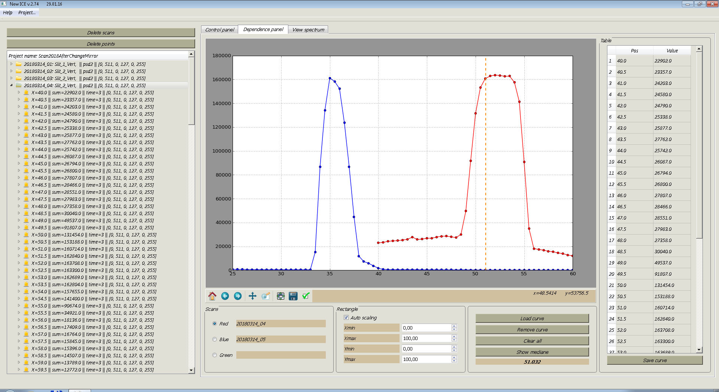
Instruments control software at the IBR-2 reactor: features and prospects
A.S. Kirilov, I.A. Morkovnikov, S.M. Murashkevich, T.B. Petukhova, L.A. Truntova
Frank Laboratory of Neutron Physics, Joint Institute for Nuclear Research, 141980 Dubna, Moscow Region, Russia.
E-mail: akirilov@jinr.ru
Introduction
The Sonix package is the main instrument control software at the IBR-2 reactor. It was originated in the beginning of 1990s for the Neutron Spectrometer with High Resolution (beam 6a of IBR-2). Later the complex was transferred to other instruments, including those located outside FLNP. A little bit less than 20 installations are in operation now. When developing the complex, we were guided both by world trends as well as by the specifics of our laboratory. Many important requirements were formulated by our users, therefore they can be considered as real co-authors of the project.
The modular organization of the software and use of the Python language for describing the experimental script make it relatively easy to adapt it to the specific features of various instruments.
The universal GUI based on the set of PyQt widgets can be used to control the experiment without further refinement. It provides all the necessary functions, including, preparing a task for the experiment, launching it, monitoring the current values of the parameters, and spectra visualizing. In addition, there are some instrument tuning programs and other useful tools.
Besides an instrument control itself, the complex also includes remote measurement supervising subsystem and the central repository for measurement results.
The Journal system provides automatic data logging of measurements.
The Microsoft Windows is used as an operating system on control computers.
Spectra visualization
The Spectra Viewer is designed to visualize data from mono detectors, 1D PSD and 2D PSD. Spectra can be read from files (including zipped files) or from the DAQ controllers directly. The matplotlib library is used to display the graph. The panel implements typical operations like scaling, shifting, etc.
Universal GUI at the Greins instriment
Visualisation of spectra from monodetectors with SpectraViewer
User interfaces
We proposed and implemented a universal GUI approach. This means that the same set of clients is enough to manage an arbitrary instrument.
There are three types of interfaces in the Sonix+: the main one is the graphical interface, for remote supervising - the web interface and at thelowest level - command line.
The command line prompts you to enter commands as a Python string, using any Python shell, for example, PythonWin.
There are the universal graphical interface (GUI) and some specialized ones.
The universal GUI is available at all instruments. It is organized according to principle – each sub window is dedicated to one of the main user’s needs. There are three main needs to watch: current state of the instrument, the measurement history (log file), the spectra visualization. The fourth need is to control the measurement process. The universal interface is assembled from separate components, each of which implements an self-completed function, for example, visualization of spectra, exposure control, motor conrtrol etc. These components are implemented in PyQt.
There are additional clients as well for the Sonix+ loading, instrument configuration editing and some else.
Specialized GUI can be created by special requests, for instance, for instrument tuning.
Journal user interface
Central file repositary and the registration system Journal
The Journal is the system for automatic measurement registration, developed at FLNP. Registered information is stored in the specialized database on one of the central servers of the laboratory. The data measured on these instruments are automatically stored in the repository. The Journal system serves to work with files in the repository, organize search by parameter values and making reports on measurements.
WebSonix service
The service is designed for remote measurement monitoring and instrument control. It includes the central website and modules for communication with instrument control computers.
Service was designed as a universal tool and can be easily adapted to the specific features of any instrument. The main page of the WebSonix pages are organized in the same way as the universal GUI.
Specialized GUI
Specialized GUIs are developed on the base set of the Sonix + widgets. They are designed either for specific instruments like D3 - the powder diffractometer at the Neutron Complex for Materials Research in the Institute of Metal Physics (Zarechny) or for performing specific measurements.
For example, the ICE (Integrated Calibration Environment) program below was developed for tuning the IBR-2 reflectometers before the main measurement.
Sonix+ structure
The Sonix+ is a unified, universal set of modules. Sonix + is mostly local system. Computation power of modern computers usually is sufficient to do the whole job. For those applications that require synchronization with external computers special modules are provided.
In a modular system every component is responsible for some device or function. Drivers serve hardware devices – they are at a lower level of the hierarchy.
Servers and adapters are at higher level of hierarchy. Among them the "DAQ server" and "Script interpreter" are the most essential. The first is responsible for synchronous management control of all detectors, the second - for execution of experiment procedure. In Sonix+ the script is complete program in the Python language.
Other modules ("List", "Linear adapter", "Fifo", etc.) implement the different functions simplifying the organization of measurement process. For instance, the "Command channel" module can be used for contact with the external computer, for example, with the WebSonix server.
All modules interact on the basis of the uniform protocol which is implemented by means of so-called "database" Varman. The current status of measurement is reflected in Varman completely.
To install Sonix+ at new instrument servers can be used without redesign.
Python is also used to collect a library of spectrometer operations ("Library"), as well as for configuring the instrument ("Configuration"), which largely determine the set of the equipment and the specifics of instrument measurement procedure.
ICE control panel
WebSonix pages
Conclusion
In general, the success of the Sonix + project is confirmed by practice. The structure is well-established, and the upgrade of the lower level modules is primarily due to the transition to Visual studio 2017 and the replacement of Python 2 with Python 3.
At the same time, as was to be expected, some of the previous decisions should be revised in accordance with the emerging needs and opportunities.
The introduction of new DAQ controllers (DeliDaq2 and CAEN N6730 digitizer) provides for recording the results in the form of event files and their subsequent histogramming.
In the GUI, PyQt4 will be replaced by PyQt5. The SpectraViewer visualization program is constantly updated with new features. It is planned to regesign the ICE program in order to simplify the structure and user interface.
It is supposed to return the experiment control function to the WebSonix on more secure basis. as it was recently.
The Journal user interface will be developed to provide the user direct access to the repository.
ICE dependence panel
References
https://sonix.jinr.ru/wiki/doku.php?id=en:index

